Slide 1


AMAZON AND EBAY

Slide 2

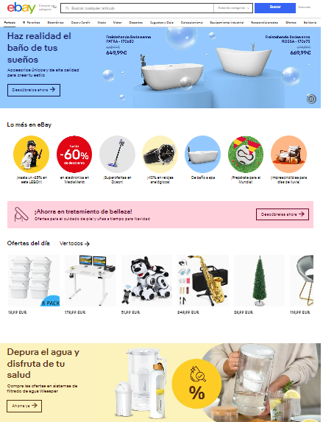

Slide 3



Strive for consistency

Slide 4
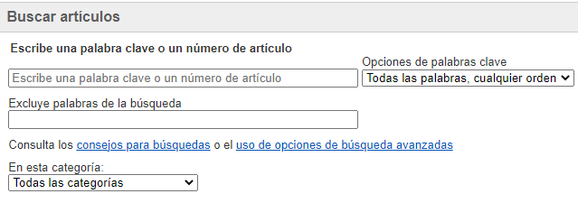
2. Seek Universal Usability
Golden Rules | Amazon | Ebay
2. Seek Universal Usability | 6 | 7

Slide 5


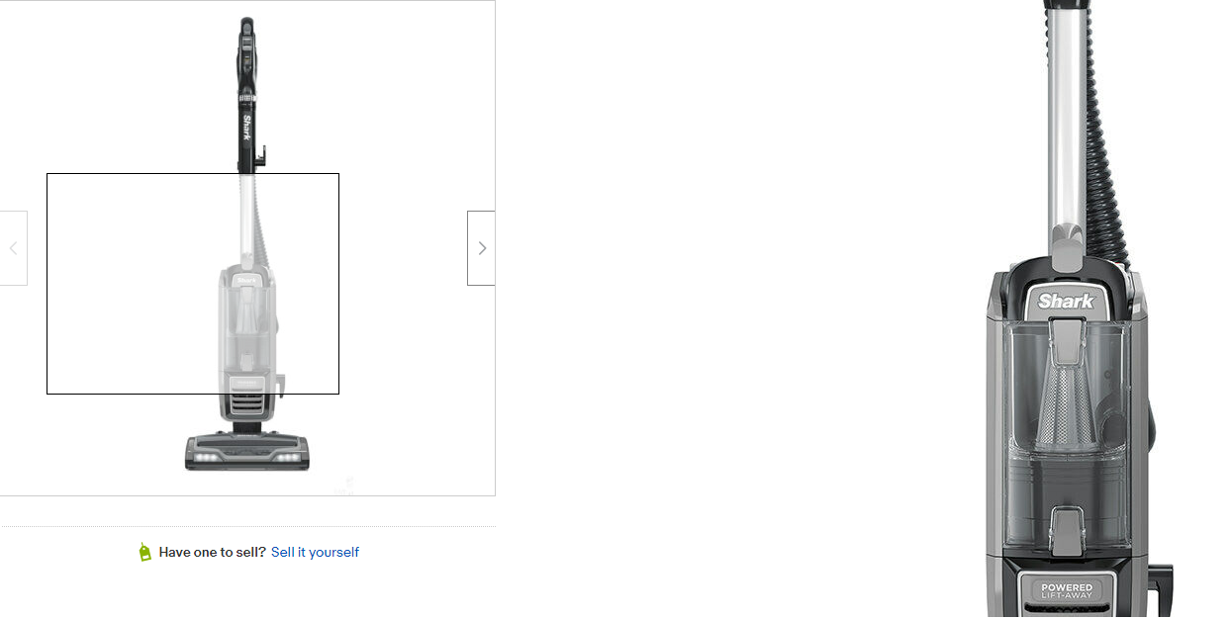
3. Offer informative feedback

Slide 6
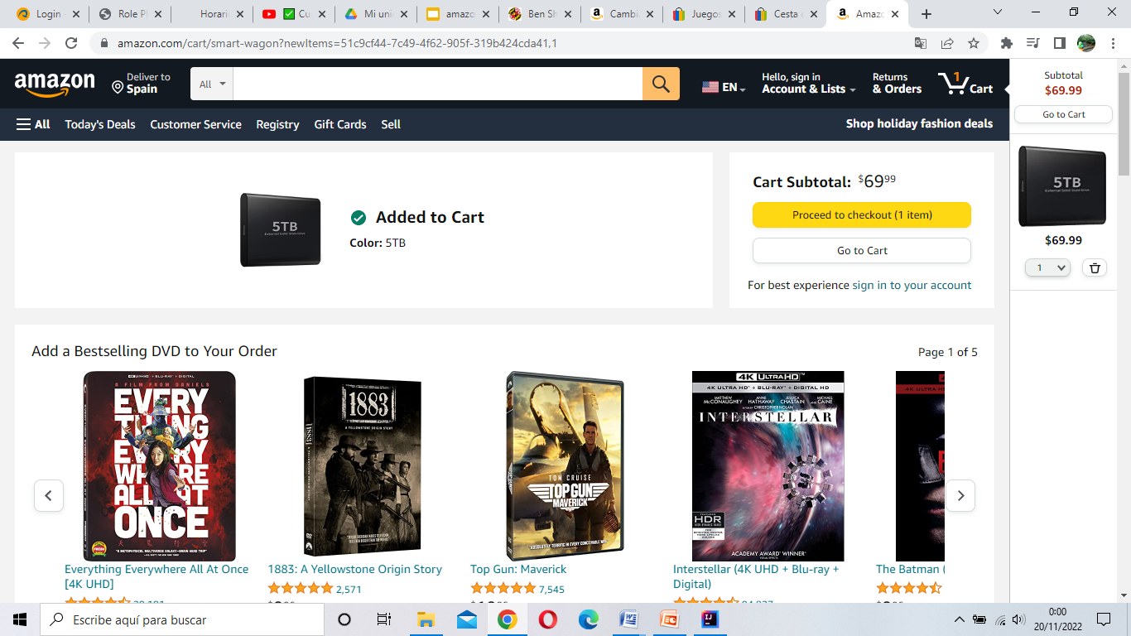
4. Design Dialogues to Yield Closure
Golden Rules | Amazon | Ebay
4. Design Dialogues to Yield Closure | 6 | 7

Slide 7
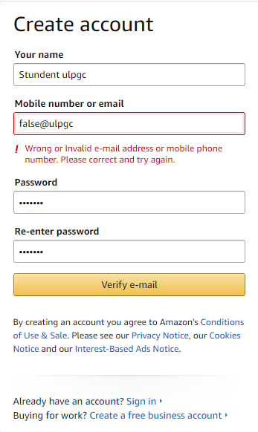
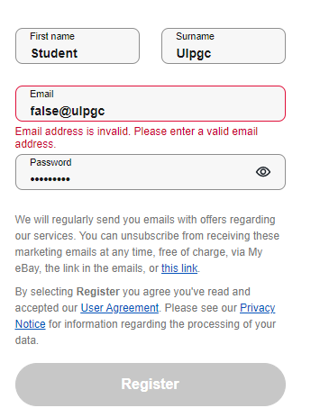
5. Prevent errors

Slide 8
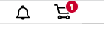
6. Permit Easy Reversal
Golden Rules | Amazon | Ebay
6. Permit Easy Reversal | 9 | 8

Slide 9

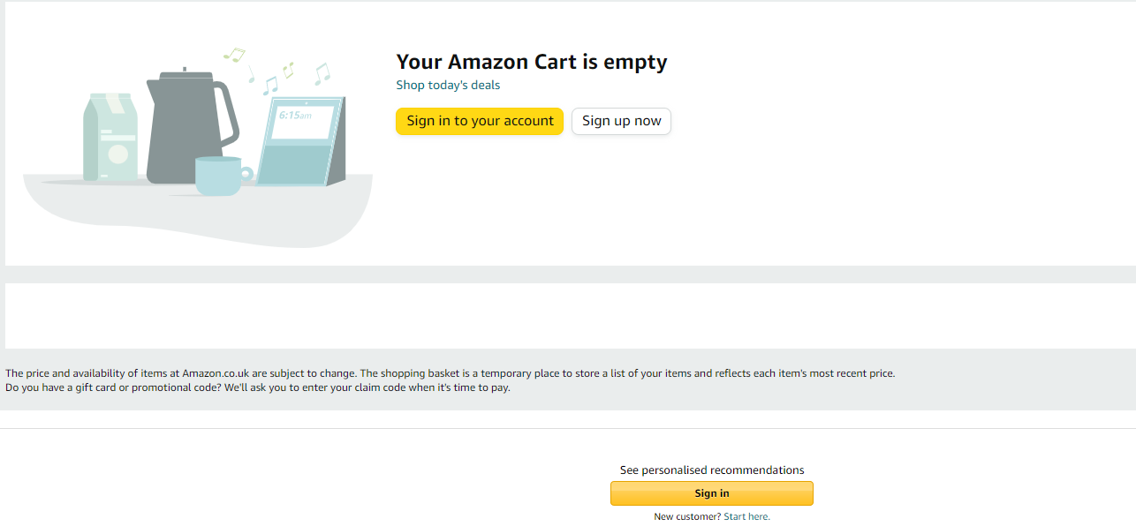

7. Keep users in control

Slide 10
8. Reduce Short-Term Memory Load
Golden Rules | Amazon | Ebay
8. Reduce Short-Term Memory Load | 7 | 8

Slide 11
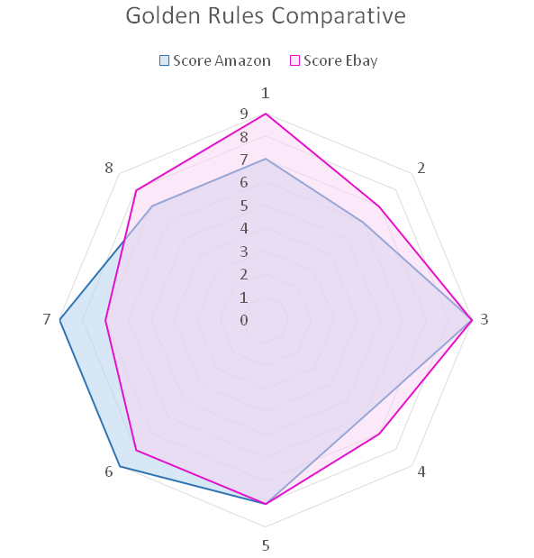
Golden rules | Amazon | Ebay
1. Strive for Consistency | 7 | 9
2. Seek Universal Usability | 6 | 7
3. Offer Informative Feedback | 9 | 9
4. Design Dialogues to Yield Closure | 6 | 7
5. Prevent Errors | 8 | 8
6. Permit Easy Reversa | 9 | 8
7. Keep Users in Control | 9 | 7
8. Reduce Short-Term Memory Load | 7 | 8

Slide 12
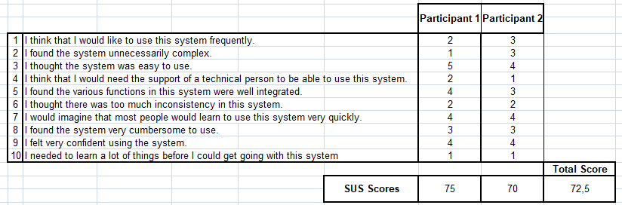
System Usability Scale Test

